Slide 1
SQL Bootcamp
Noble Desktop

Slide 2
Joins

Slide 3

Joins
Combine data across tables
Relies on primary/foreign keys

Slide 4


Rows are matched via primary/foreign keys and glued end-to-end

Slide 5
inner Join
If any primary/foreign key is missing, row is ignored
Results may be smaller than either table being joined

Slide 6
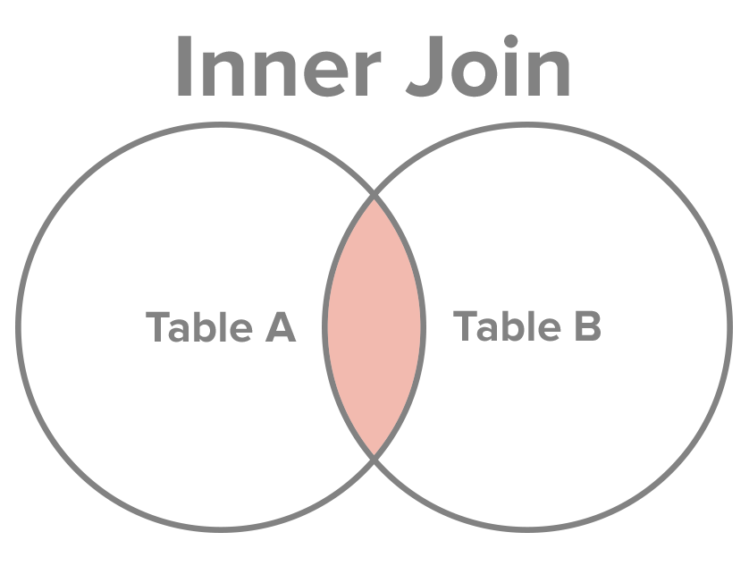

Slide 7
Inner Join
SELECT name, email FROM purchases INNER JOIN users on purchases.user_id = users.id

Slide 8
Aliases
Nickname for a table or column in query
Usually only a letter or two, to make query shorter

Slide 9
Aliases
SELECT * FROM
JOIN products as pr,
purchases as pu;

Slide 10
Aliases
SELECT * FROM
JOIN products as pro,
purchases as pur;

Slide 11
Exercises

Slide 12
full (outer) Join
Missing primary/foreign key is row is filled with nulls
Results will be size of largest table being joined

Slide 14
(full) outer Join
SELECT name, email FROM purchases FULL OUTER JOIN users on purchases.user_id = users.id

Slide 15
Left (outer) Join
Missing primary/foreign key is row is filled with nulls
Results will be size of largest table being joined

Slide 16
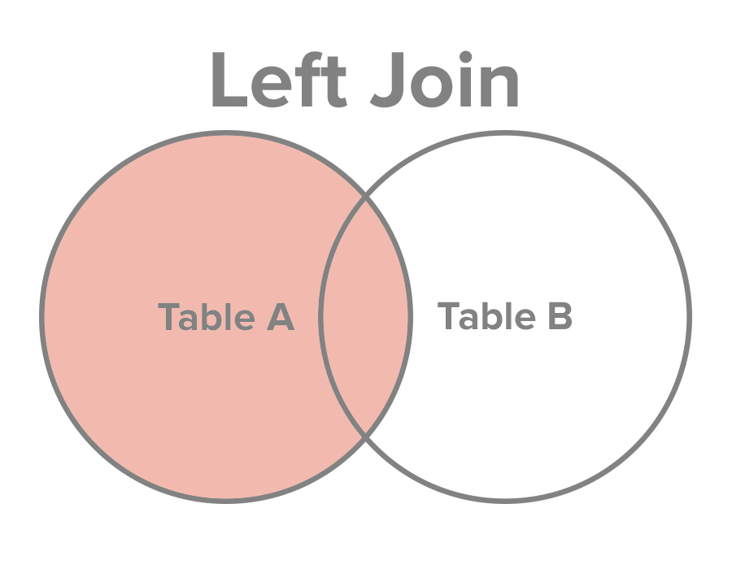

Slide 17
Left (Outer) Join
SELECT name, email from purchases LEFT OUTER JOIN users on purchases.user_id = users.id

Slide 18
RIGHT (outer) Join
Missing primary/foreign key is row is filled with nulls
Results will be size of largest table being joined

Slide 20
Right (Outer) Join
SELECT name, email from purchases RIGHT OUTER JOIN users on purchases.user_id = users.id

Slide 21
Exercises

Slide 22
Conditionals and Unions

Slide 23
Conditional
select title,
case when (price < 100)
then 'cheap'
else 'expensive'
end from products;

Slide 24
union
select email from users
union
select password from users;

Slide 25
Union
Both queries must output same number of columns
Data types of columns must be compatible

Slide 26
Round
SELECT * FROM products
WHERE price <= 1000;

Slide 27
Lower, Upper, INITCAP
SELECT lower(name) FROM purchases;

Slide 28
Exercises

